Slide 1
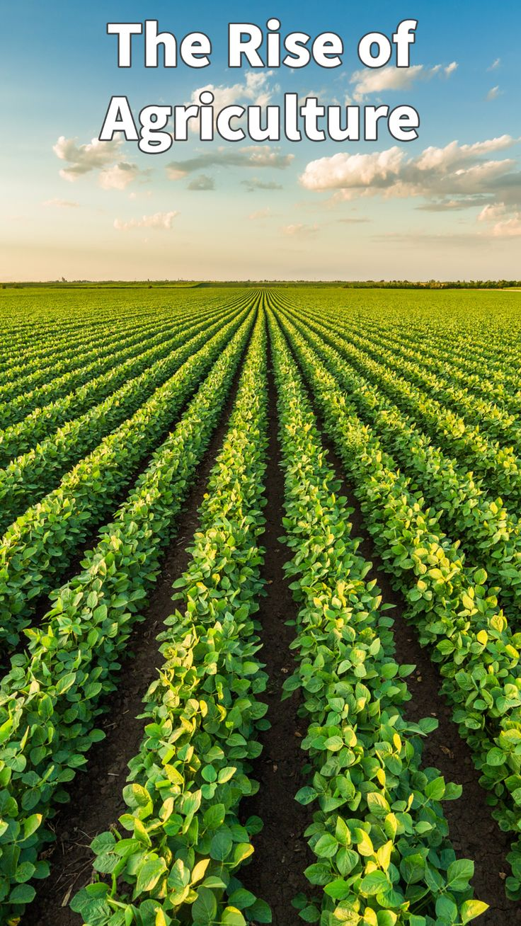
Food and Agriculture
Tech-enabled solutions for a more sustainable and food-secure future

Slide 2
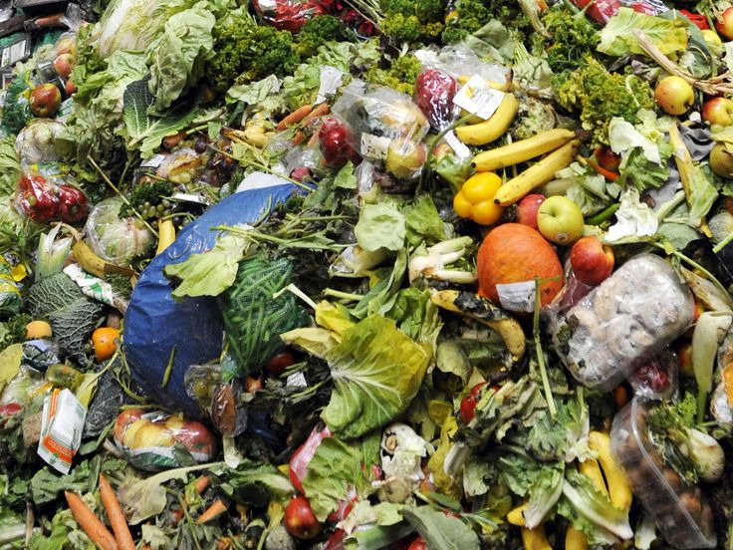
The Challenges Facing Food and Agriculture
Food security: 1 in 9 people lack access to sufficient food
Sustainability: agriculture is a significant contributor to greenhouse gas emissions and water pollution
Waste: 1/3 of all food produced is lost or wasted

Slide 3
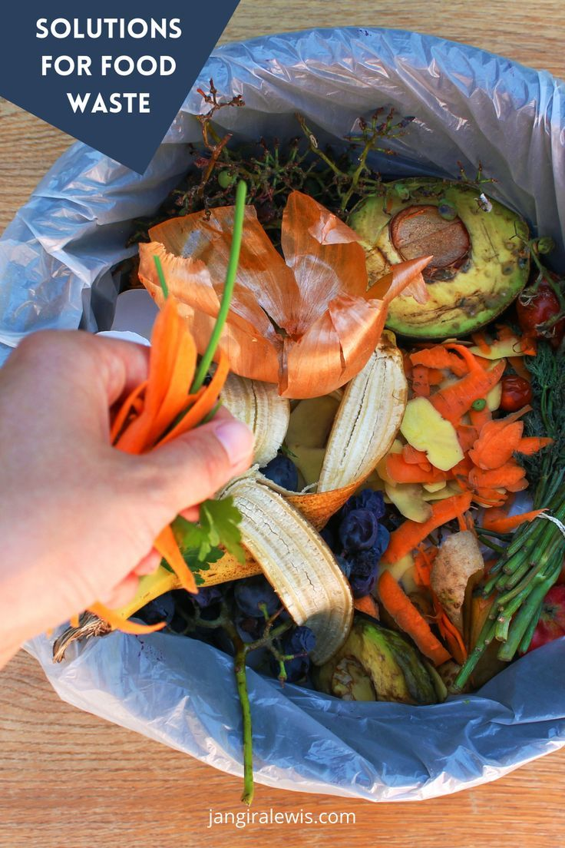
Tech-enabled Solutions for Food and Agriculture
Increasing yield through precision agriculture and vertical farming
Reducing waste through efficient supply chain management and innovative packaging
Improving food security through digital platforms and inclusive food systems
Ensuring sustainability through regenerative agriculture and renewable energy

Slide 4
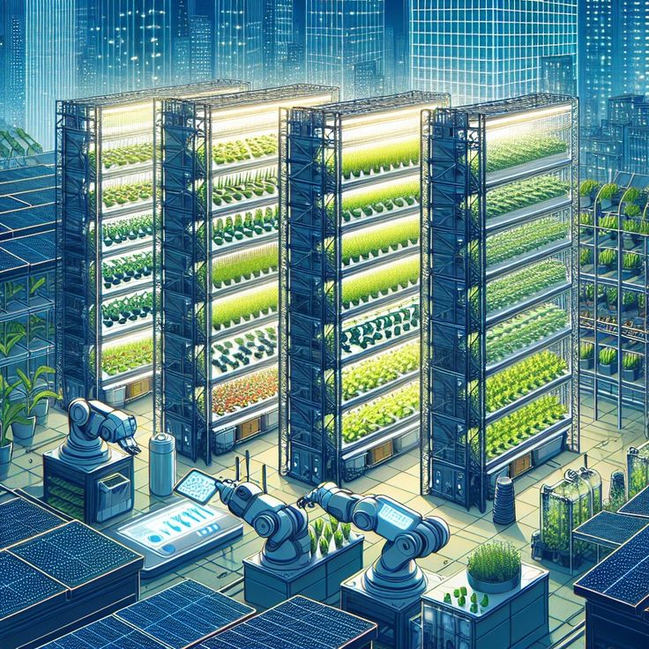
Precision Agriculture and Vertical Farming
Precision irrigation systems: optimizing water usage with Python-based sensor data analysis
Crop monitoring: using drones, satellite imaging, and IoT sensors to identify optimal crop varieties and planting schedules
Data analytics: identifying trends and patterns to improve crop yields
import pandas as pd
import numpy as np
# Load sensor data
sensor_data = pd.read_csv('sensor_data.csv')
# Calculate optimal water usage
optimal_water_usage = np.mean(sensor_data['soil_moisture']) * 0.8
print("Optimal water usage:", optimal_water_usage)

Slide 5
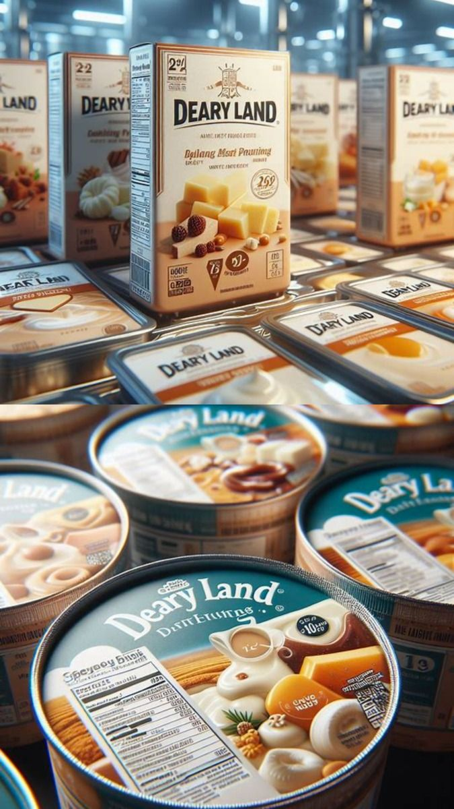
Efficient Supply Chain Management and Innovative Packaging
Implementing efficient supply chain management systems to reduce food waste during transportation and storage
Developing innovative packaging solutions to extend shelf life and reduce food spoilage
Creating food recovery systems to redistribute surplus food to those in need
import pandas as pd
# Load supply chain data
supply_chain_data = pd.read_csv('supply_chain_data.csv')
# Identify inefficiencies in the supply chain
inefficiencies = supply_chain_data[supply_chain_data['transportation_time'] > 5]
print("Inefficiencies in the supply chain:", inefficiencies)

Slide 6
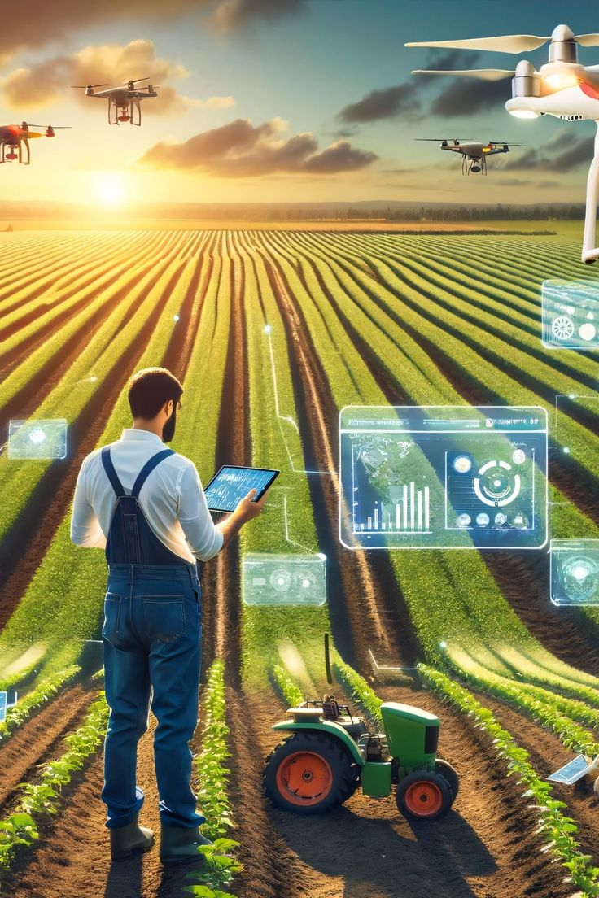
Digital Platforms and Inclusive Food Systems
Developing digital platforms to connect farmers with consumers, reducing intermediaries and increasing access to fresh produce
Implementing mobile-based solutions for farmers to access market information, weather updates, and best practices
Creating inclusive and equitable food systems that promote access to nutritious food for all
import flask
app = flask.Flask(_name_)
@app.route('/market_info', methods=['GET'])
def get_market_info():
market_info = {'price': 10, 'weather': 'sunny'}
return jsonify(market_info)
if _name_ == '_main_':
app.run()

Slide 7
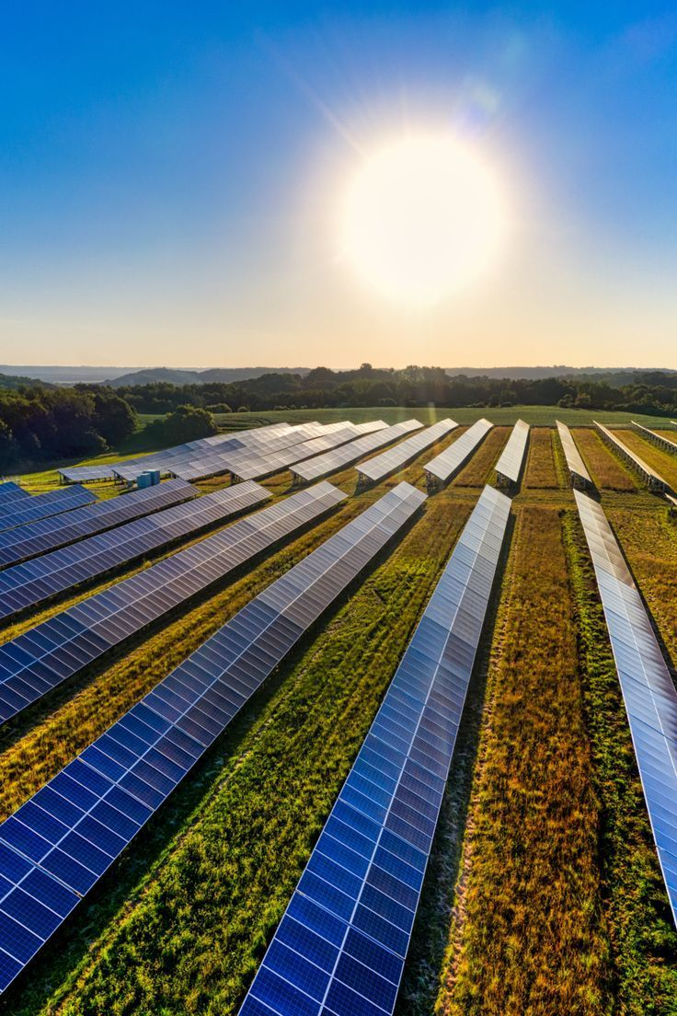
Regenerative Agriculture and Renewable Energy
Promoting regenerative agriculture practices that enhance soil health, biodiversity, and ecosystem services
Developing sustainable water management systems to reduce water usage and protect water resources
Implementing renewable energy solutions to power food production, processing, and distribution
import pandas as pd
# Load energy usage data
energy_usage_data = pd.read_csv('energy_usage_data.csv')
# Calculate renewable energy potential
renewable_energy_potential = energy_usage_data['solar_radiation'] * 0.2
print("Renewable energy potential:", renewable_energy_potential)

Slide 8
Tech-enabled Solutions for a Sustainable and Food-secure Future
Call to action: "Join us in developing tech-enabled solutions for food and agriculture
Protect crops, boost yield and make urban areas suitable for farming
Ensure food safety as it can monitor equipment conditions
Identifying areas of waste

